Slide 1
Li’l Me
20111043 서광균

Slide 2
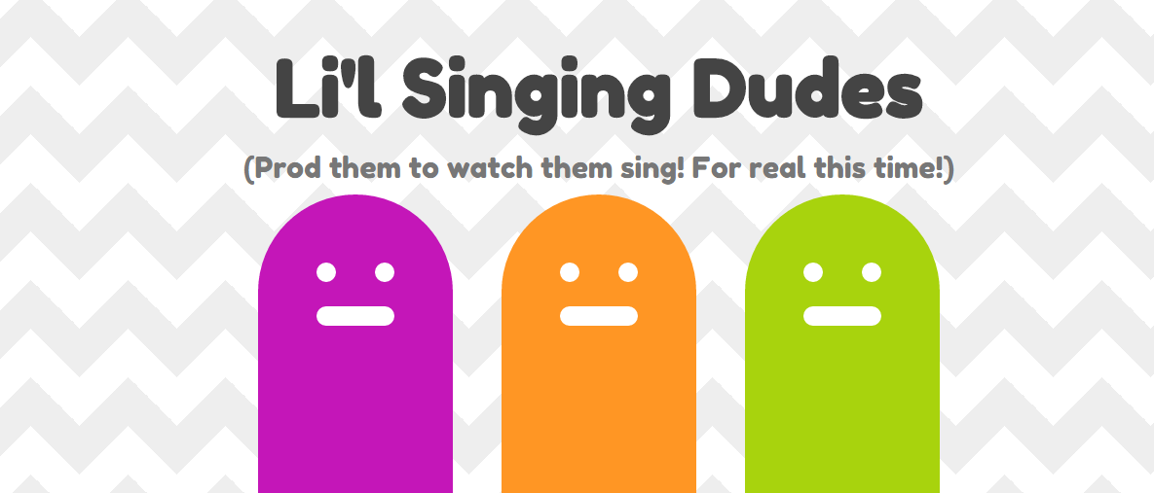

Slide 3
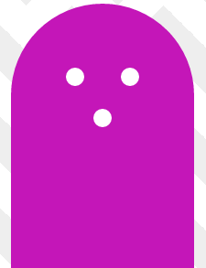


How does it work?
‘O’

Slide 4
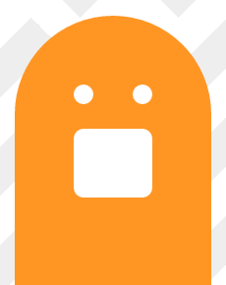
How does it work?
‘A’

Slide 5
TECHNOLOGY
Pitch tracking
→ Need to find the harmonic frequencies of the vowel
→ Change the motion of the Li’l Me

Slide 6
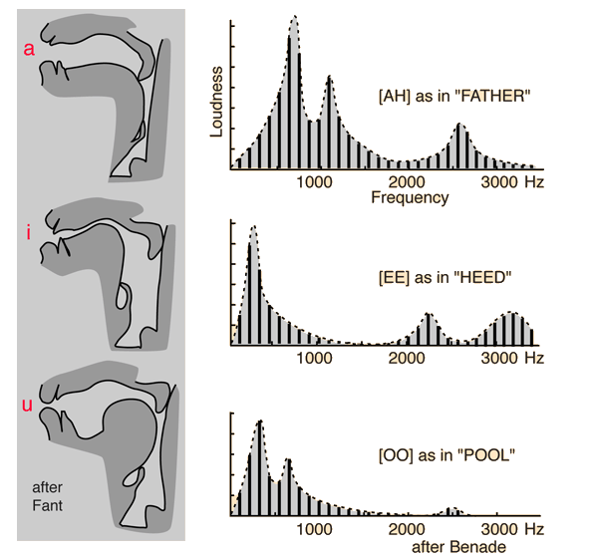

Slide 7

TECHNOLOGY
Pitch tracking
→ Need to find the harmonic frequencies of the vowels
→ Change the motion of the Li’l Me

Slide 8
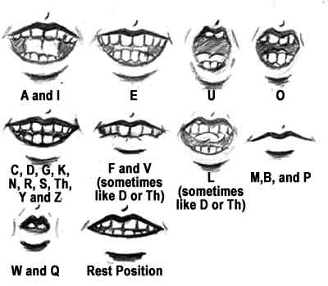

Slide 9
What can be done further?
Add filter Delay, and Reverb
Does this have an effect on the harmonic frequency
Add another interaction method
not only pitch but also loudness can be shown
Make a Game
something like ‘Guitar Hero’

Slide 10
Q&A

